Slide 1
Chapter 4
Authentication Applications

Slide 2
We cannot enter into alliance with neighboring princes until we are acquainted with their designs. We are not fit to lead an army on the march unless we are familiar with the face of the country--its mountains and forests, its pitfalls and precipices, its marshes and swamps.
—The Art of War, Sun Tzu
是故不知诸侯之谋者，不能预交。不知山林、险阻、沮泽之形者，不能行军。
— 《孙子兵法》九地篇
Notes:
所以不了解诸侯各国的图谋，就不要和他们结成联盟；不知道山林、险阻和沼泽的地形分布，不能行军。

Slide 3
Outline
Introduction
Kerberos
X.509 Authentication Service
Recommended reading and Web Sites

Slide 4
Authentication Applications
Authentication functions
  developed to support application-level authentication & digital signatures
Kerberos
  a secret-key authentication service
X.509
  a public-key directory authentication service
Notes:
This chapter examines some of the authentication functions that have been developed to support application-level authentication and digital signatures.
Will first look at one of the earliest and most widely used services: Kerberos. Then examine the X.509 directory authentication service.

Slide 5

KERBEROS
In Greek mythology, a many headed dog, the guardian of the entrance of Hades
Notes:
希腊神话中的地域看门犬，（在希腊神话中，死人在进入冥界时要先乘坐卡戎划的船渡过冥河），为冥王哈迪斯看守冥界的大门Kerberos允许每一个死者的灵魂进入冥界，但不让任何人出去（同时也不允许活人出入）

Slide 6
KERBEROS
Users wish to access services on servers.
Three threats exist:
  User pretend to be another user.
  User alter the network address of a workstation.
  User eavesdrop on exchanges and use a replay attack.
Notes:
Kerberos要解决的问题是，假设在一个开放的分布式环境中，工作站的用户希望访问分布在网络各处的服务器上的服务。
这时候可能存在三个威胁：
一个用户可能进入一个特定的工作站，并冒充使用哪个工作站的其他用户。
一个用户可能改变一个工作站的网络地址，是的从此工作站发出的请求好像是从被伪装的工作站发出的。
一个用户可能窃听信息交换，并使用重放攻击来获得许可连接服务器，或是破坏正常操作。

Slide 7
KERBEROS
A centralized authentication server
  From MIT
  To authenticate users to servers and servers to users
  Relies on conventional encryption
    Making no use of public-key encryption
  Allows users to access services distributed in network
    Without needing to trust all workstations
    All trust a central authentication server
Two versions: version 4 and 5
  Version 4 makes use of DES
Notes:
这里Kerberos是一种认证服务，这种认证服务作为雅典娜家骅的一个组成部分，最早是由MIT开发。
Kerberos采取集中的认证服务器来实现用户对服务器的认证和服务器对用户的认证。
Kerberos仅使用堆成加密体系，而不使用公钥加密体系。
目前有两个版本，版本4的实现方案使用DES加密，虽然逐步在被淘汰，但仍然有小部分认证服务在使用。版本5修改了一些版本4中的安全缺陷，已经发布为提议的Internet标准。

Slide 8
Kerberos v4 Overview
a basic 3rd-party authentication scheme
have an Authentication Server (AS)
  users initially negotiate with AS to identify self
  AS provides a non-corruptible authentication credential
    ticket granting ticket (TGT)
have a Ticket Granting server (TGS)
  users subsequently request access to other services from TGS based on users’ TGT
Notes:
Kerberos版本4是一个第三方的认证机制，通常会使用一个认证服务器，它指导所有用户的口令，并把它们存储在集中式数据库中，另外，这个认证服务器与每个服务器之间共享一个独立的密钥，这些密钥可以通过物理途径或其他安全途径进行了发放。
通常有一个票据授权服务器，用户发送访问请求后，可以由票据授权服务器发送可登陆票据。

Slide 9
Kerberos Version 4
Terms:
  C = Client
  AS = authentication server
  V = server
  IDc = identifier of user on C
  IDv = identifier of V
  P_{c} = password of user on C
  ADc = network address of C
  Kv = secret encryption key shared by AS and V
  TS = timestamp
  || = concatenation
Notes:
C=客户端
AS=认证服务器
V=服务器
Idc=客户端上用户的身份标识
Idv =服务器的身份标识
Pc=客户端上用户的口令
Adc=客户端的网络地址
Kv=认证服务器和服务器间共享的加密密钥

Slide 10
A Simple Authentication Dialogue
C  AS: IDc || P_{c} || IDv
AS  C: Ticket
C  V: IDc || Ticket
Ticket = E_{Kv}[IDc || P_{c} || IDv]
Kv shared by AS and Sever (V)
Ticket can be decrypted by Server
Notes:
用户登录一个服务器，并请求访问服务器V，用户工作站中的客户端模块C请求用户输入口令，然后向AS发送一条包含用户ID、服务器ID和用户口令的消息。
AS查看它的数据库，检查用户是否提供了对于这个用户ID的正确口令，并检查这个用户是否被允许访问服务器V。如果两个检测均通过，AS接收此用户为真实的，并在此时通知立即通知服务器此用户是真实的。
这其中，AS创建一个票据（ticket），这个票据包含用户ID、用户网络地址和服务器ID。这个票据用AS和此服务器共享的密钥进行加密。之后将票据送回C。由于这个票据是加过密的，C或者攻击者都无法篡改它。
利用这张票据，C现在可以向V请求服务，C向V发出一个包含C的ID和上述票据的信息。V对票据进行解密，并验证票据中的用户ID是否与消息中未加密的用户ID相同。如果两者匹配，服务器则认为用户是被授权的，并准许被请求的服务。

Slide 11
Kerberos v4 Dialogue
obtain ticket granting ticket from AS
  once per session
obtain service granting ticket from TGS
  for each distinct service required
client/server exchange to obtain service
  on every service request
Notes:
Kerberos认证的会话，解释PPT

Slide 12
Version 4 Authentication Dialogue
Threat
  An opponent will steal the ticket-granting ticket and use it before it expires
Countermeasure
  How to decide the lifetime associated with the ticket-granting ticket?
    If too short  repeatedly asked for password
    If too long  greater opportunity to replay
Notes:
解释ppt

Slide 13
Version 4 Authentication Dialogue
Authentication Service Exhange: To obtain Ticket-Granting Ticket
C  AS: IDc || IDtgs ||TS1
AS  C: E_{Kc} [K_{c,tgs}|| IDtgs || TS₂ || Lifetime₂ || Tickettgs]
Ticket-Granting Service Exchange: To obtain Service-Granting Ticket
(3) C  TGS: IDv ||Ticket_{tgs} ||Authenticatorc
(4) TGS  C: E_{Kc} [K_{c,v}|| IDv || TS₄ || Ticketv]
Client/Server Authentication Exhange: To Obtain Service
(5) C  V: Ticket_{v} || Authenticatorc
(6) V  C: EKc,v[TS5 +1]
Notes:
因此，我们需要提出一个新的要求，一个网络服务器必须能够确认使用票据的人就是被授予票据的人。
第二个问题是，需要服务器向用户对齐自身进行验证的情况是可能存在的，如果没有这样的验证，攻击者就可能破坏配置信息，是的送往一个服务器的消息被定向到其他节点。这个假冒的服务器就可以处在真实服务器的位置上，并可以获取用户发送的任何信息，而阻止对用户的真正服务。
针对这些问题，Kerberos协议增加了TGS来实现对票据和身份的验证。

Slide 14
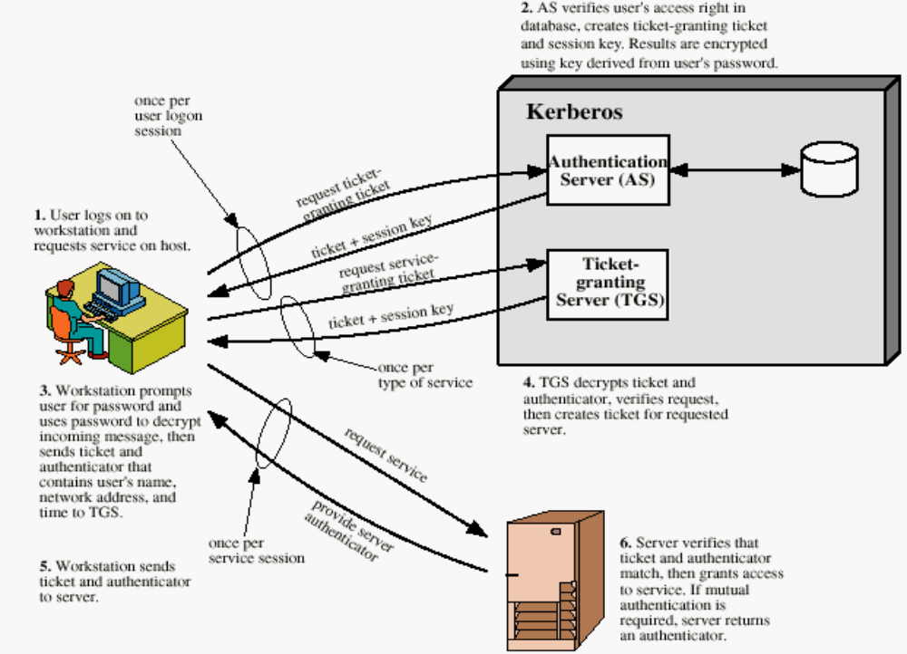
Overview of Kerberos
Notes:
用户登录工作站，请求票据授权票据

Slide 15
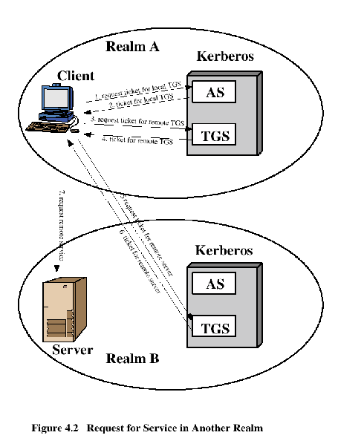
Request for Service in Another Realm

Slide 16
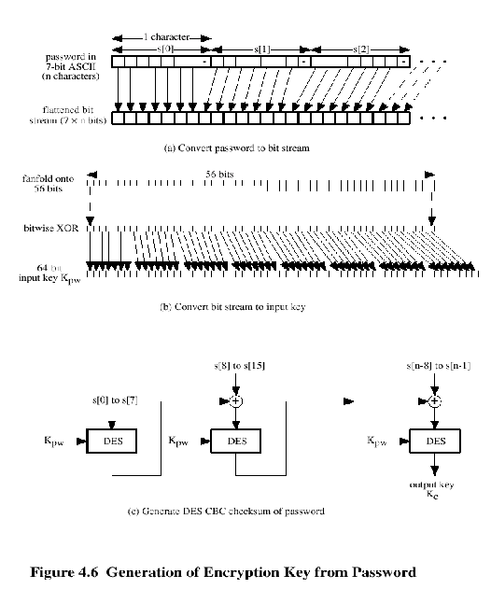
Kerberos Encryption Techniques

Slide 17
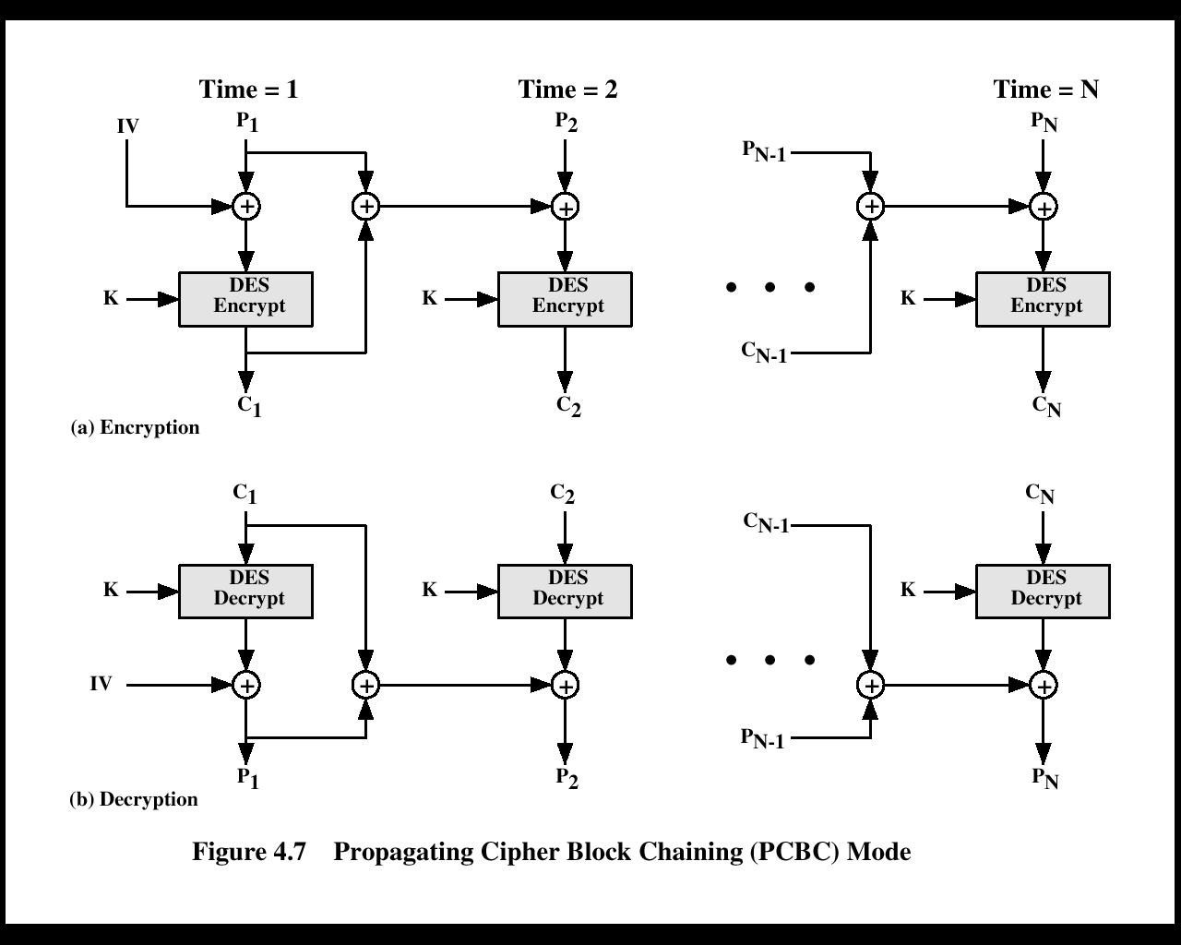
PCBC Mode

Slide 18
Kerberos - in practice
currently have two Kerberos versions:
v4
  restricted to a single realm
v5
  allows inter-realm authentication
  Kerberos v5 is an Internet standard
  specified in RFC1510, and used by many utilities
To use Kerberos:
  need to have a KDC on your network
  need to have Kerberised applications running on all participating systems
major problem - US export restrictions
  Kerberos cannot be directly distributed outside the US in source format (& binary versions must obscure crypto routine entry points and have no encryption)
  else crypto libraries must be reimplemented locally
Notes:
KDC是Kerberos Distributed Center包括AS和TGS

Slide 19
X.509 Authentication Service
A distributed set of servers that maintain a database about users.
Each certificate contains the public key of a user and is signed with the private key of a CA.
  used in S/MIME, IP Security, SSL/TLS and SET.
  RSA is recommended to use.
Notes:
X.509是一个非对称加密的密钥分配，其主要作用是处理密钥的分发问题。在这方面，使用公钥加密实际的作用包括两方面：
1. 公钥的分发，2. 使用公钥加密分发私钥。

Slide 20
X.509 Certificates
issued by a Certification Authority (CA), containing:
  version (1, 2, or 3)
  serial number (unique within CA) identifying certificate
  signature algorithm identifier
  issuer X.500 name (CA)
  period of validity (from - to dates)
  subject X.500 name (name of owner)
  subject public-key info (algorithm, parameters, key)
  issuer unique identifier (v2+)
  subject unique identifier (v2+)
  extension fields (v3)
  signature (of hash of all fields in certificate)
notation CA<<A>>
  denotes certificate for A signed by CA
Notes:
The X.509 certificate is the heart of the standard. There are 3 versions, with successively more info in the certificate - must be v2 if either unique identifier field exists, must be v3 if any extensions are used. These user certificates are assumed to be created by some trusted certification authority (CA) and placed in the directory by the CA or by the user. The directory server itself is not responsible for the creation of public keys or for the certification function; it merely provides an easily accessible location for users to obtain certificates. The certificate includes the elements shown.
The standard uses the notation for a certificate of: CA<<A>> where the CA signs the certificate for user A with its private key.

Slide 21
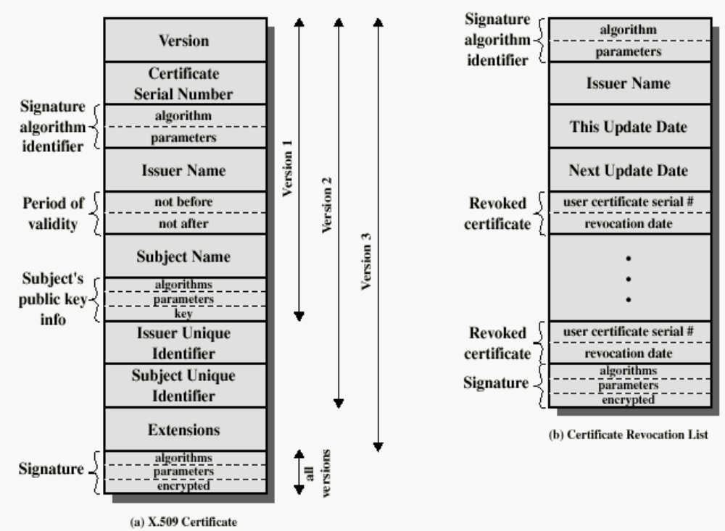
X.509 Formats

Slide 22
Obtaining a User’s Certificate
Characteristics of certificates generated by CA:
  Any user with access to the public key of the CA can recover the user public key that was certified.
  Nobody other than the CA can modify the certificate without this being detected.

Slide 23
CA Hierarchy
X1
X2
both users share a common CA
  they are assumed to know the CA’s public key
    If X<<A>> and X<<B>>, then A has B’s certificate (public key)
  otherwise CA's must form a hierarchy
    A signed by X1, B signed by X2
      If A doesn’t know X2’s public key
        B’s certificate is useless to A
      A can obtain X2’s public key from X1 if X2 is also signed by X1
        X1<<X2>>X2<<B>> -- certification path
use certificates linking members of hierarchy to validate other CA's
  each CA has certificates for clients (forward) and parent (backward)
  each client trusts parents certificates
  enable verification of any certificate from one CA by users of all other CAs in hierarchy
A
B
Notes:
If both parties use the same CA, they know its public key and can verify others certificates. If not, then there has to be some means to form a chain of certifications between the CA's used by the two parties, by the use of client and parent certificates. It is assumed that each client trusts its parents certificates.

Slide 24
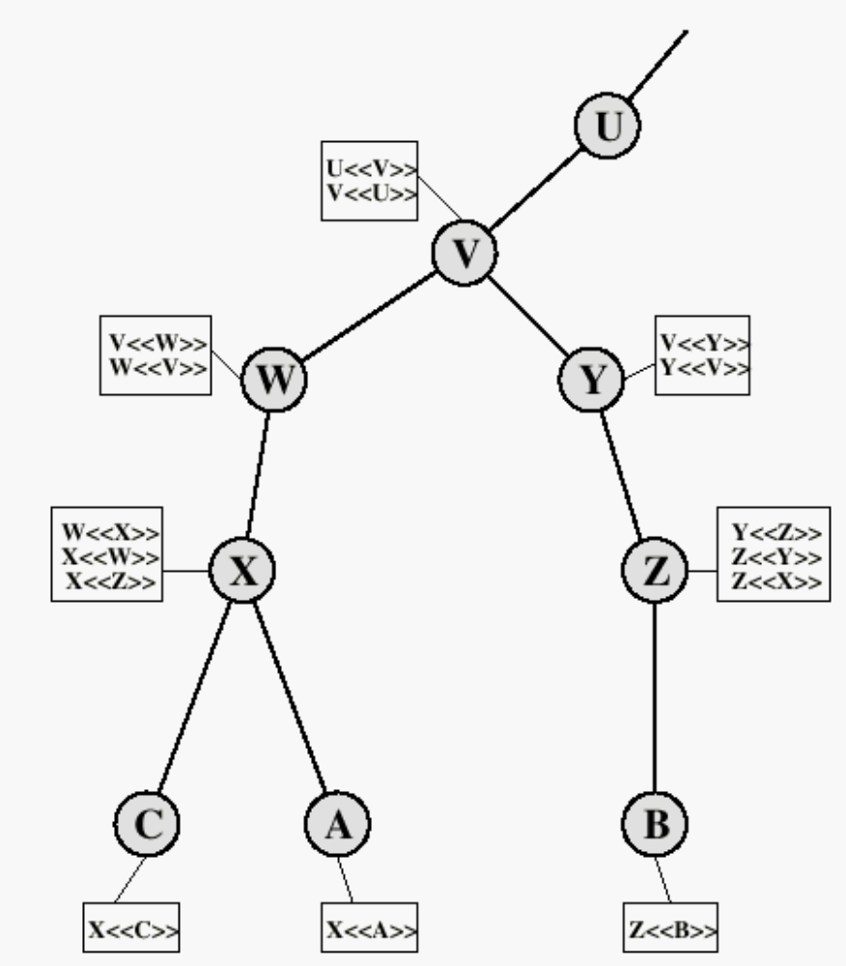
X.509 CA Hierarchy
If X<<A>>, then
(i) A knows X’s public key and
(ii) A can get all the public keys signed by X.
A establishes a certification path to B:
X<<W>>W<<V>>V<<Y>>Y<<Z>>Z<<B>>
B establishes a certification path to A:
Z<<Y>>Y<<V>>V<<W>>W<<X>>X<<A>>

Slide 25
Revocation of Certificates
Reasons for revocation:
  The user’s private key is assumed to be compromised.
  The user is no longer certified by this CA.
  The CA’s certificate is assumed to be compromised.

Slide 26
Authentication Procedures
X.509 includes three alternative authentication procedures:
  One-Way Authentication
  Two-Way Authentication
  Three-Way Authentication
all use public-key signatures
Notes:
X.509 also includes three alternative authentication procedures that are intended for use across a variety of applications, used when obtaining and using certificates. 1-way for unidirectional messages (like email), 2-way for interactive sessions when timestamps are used, 3-way for interactive sessions with no need for timestamps (and hence synchronised clocks). See Stallings Figure 14.6 for details of each of these alternatives.

Slide 27
One-Way Authentication
1 message ( A->B) used to establish
  the identity of A and that message is from A
  message was intended for B
  integrity & originality of message
message must include timestamp, nonce, B's identity and is signed by A
  Timestamp (tA)
    Message generation and expiration time
  Nonce (rA)
    Value must be unique within the expiration time
    Used to detect replay attacks
may include additional info for B
  Eg. session key
Notes:
One way authentication involves a single transfer of information from one user (A) to another (B), and establishes the details shown above. Note that only the identity of the initiating entity is verified in this process, not that of the responding entity. At a minimum, the message includes a timestamp ,a nonce, and the identity of B and is signed with A’s private key. The message may also include information to be conveyed, such as a session key for B.

Slide 28
Two-Way Authentication
2 messages (A->B, B->A) which also establishes:
  the identity of B and that reply is from B
  that reply is intended for A
  integrity & originality of reply
reply includes original nonce from A, also timestamp and nonce from B
may include additional info for A
Notes:
Two-way authentication thus permits both parties in a communication to verify the identity of the other, thus additionally establishing the above details. The reply message includes the nonce from A, to validate the reply. It also includes a timestamp and nonce generated by B, and possible additional information for A.

Slide 29
Three-Way Authentication
3 messages (A->B, B->A, A->B) to enable above authentication without synchronized clocks
has reply from A back to B containing signed copy of nonce from B
  means that timestamps need not be checked or relied upon
Notes:
Three-Way Authentication includes a final message from A to B, which contains a signed copy of the nonce, so that timestamps need not be checked, for use when synchronized clocks are not available.

Slide 30
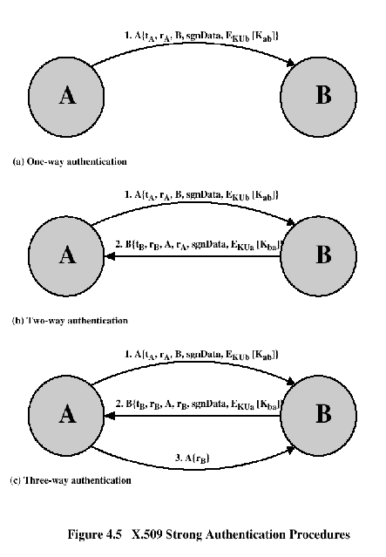
Authentication Procedures

Slide 31
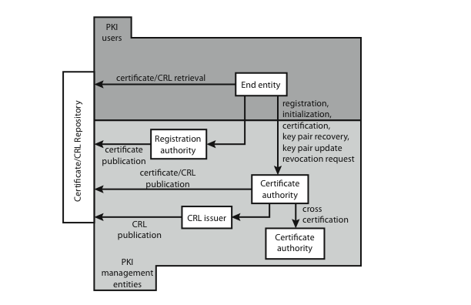
Public Key Infrastructure (PKI)
PKI – the set of hardware, software, people, policies, and procedures needed to create, manage, store, distribute, and revoke digital certificates based on asymmetric cryptography.
  based on X.509
Notes:
RFC 2822 (Internet Security Glossary) defines public-key infrastructure (PKI) as the set of hardware, software, people, policies, and procedures needed to create, manage, store, distribute, and revoke digital certificates based on asymmetric cryptography. The IETF Public Key Infrastructure X.509 (PKIX) working group has setup a formal (and generic) model based on X.509 that is suitable for deploying a certificate-based architecture on the Internet.
Stallings Figure 14.7 shows the interrelationship among the key elements of the PKIX model, and lists the various management functions needed.

Slide 32
Recommended Reading and WEB Sites
www.whatis.com (search for kerberos)
Bryant, W. Designing an Authentication System: A Dialogue in Four Scenes. http://web.mit.edu/kerberos/www/dialogue.html
Kohl, J.; Neuman, B. “The Evolotion of the Kerberos Authentication Service” http://web.mit.edu/kerberos/www/papers.html
http://www.isi.edu/gost/info/kerberos/

